Slide 1

NEXTFLICK
A Linear Algebra Approach to Movie Recommendations

Slide 2

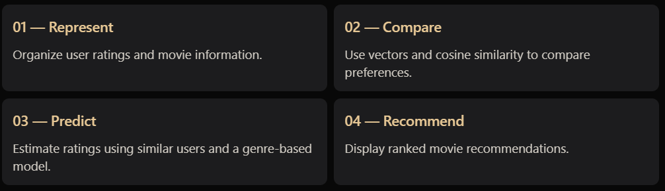
THE PROBLEM
Every user has a taste.
How do we find users who think alike?
Millions of possible preferences. Thousands of movies. How can we identify meaningful similarities from rating data?
Our Central Question-
Can linear algebra help us discover similar tastes and recommend unseen movies?

Slide 3
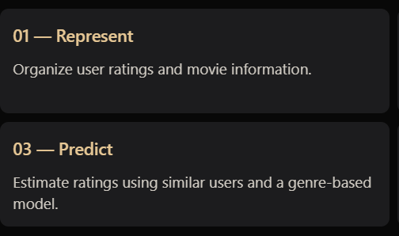
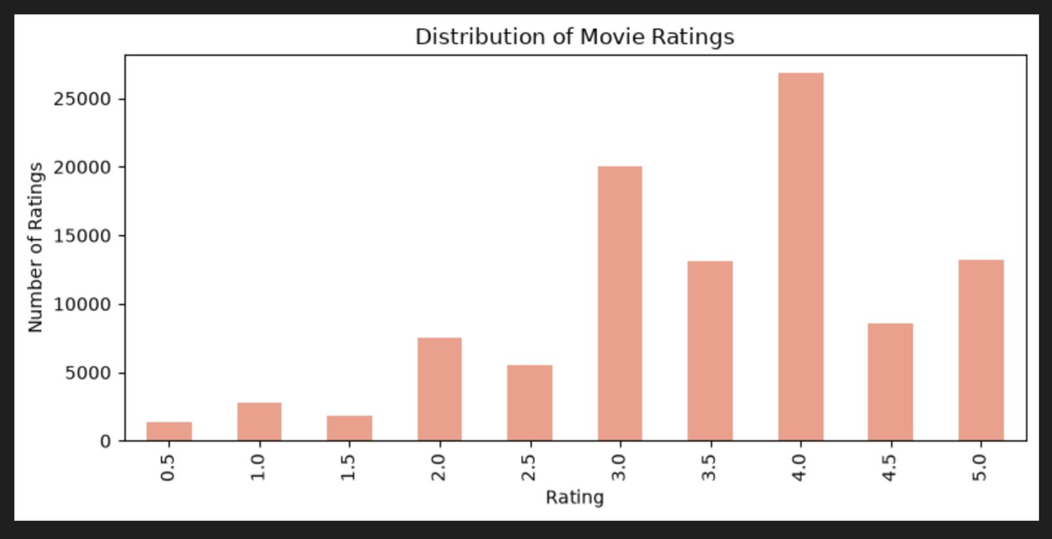
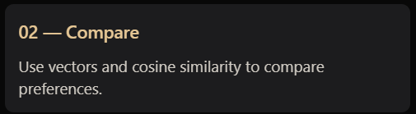
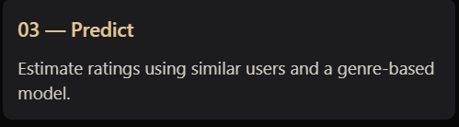

Introducing NextFlick
From user preferences to personalized recommendations.
NextFlick applies linear algebra to movie-rating data to identify similar users and estimate ratings for unseen movies.

Slide 4
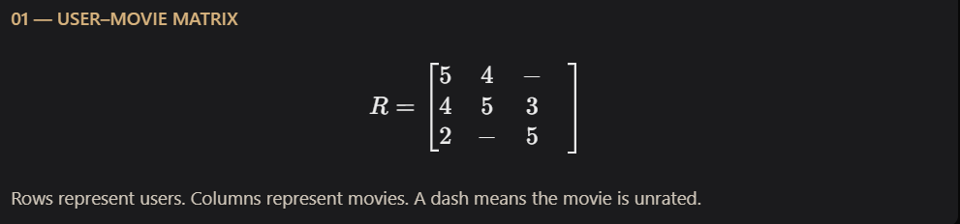
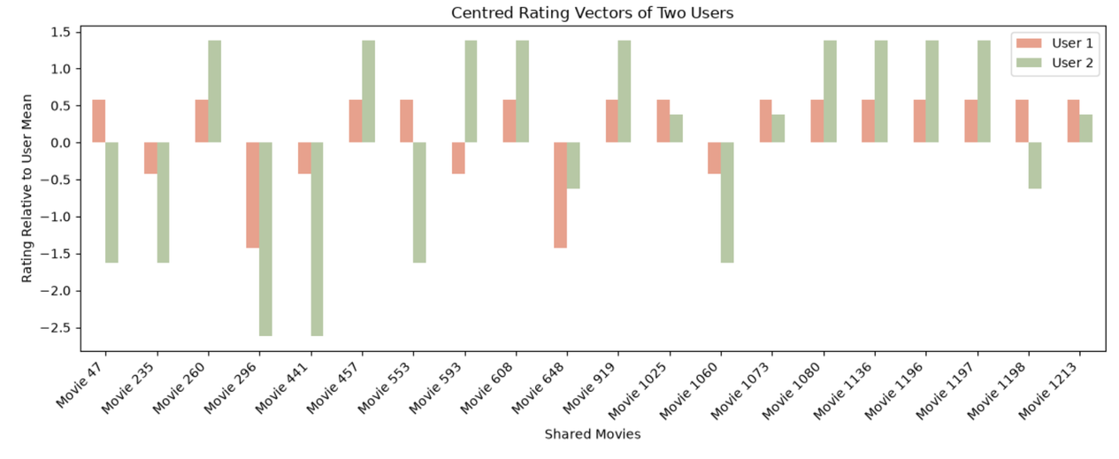
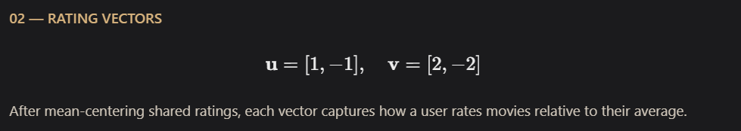
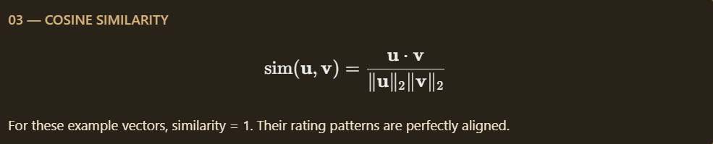
The Mathematics Behind NextFlick
Turning preferences into vectors.
Every user's movie ratings form a numerical representation of their preferences.

Slide 5
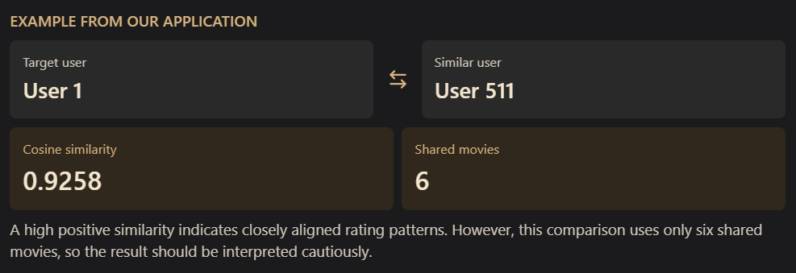

Finding Similar Users
Similar tastes. Measurable mathematically.
NextFlick compares users using their mean-centred ratings for movies they have both rated.

Slide 6
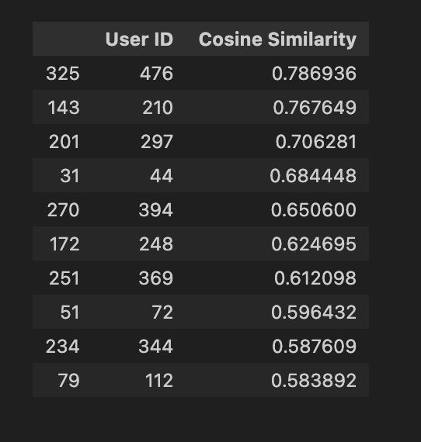
Finding Similar Users

Slide 7
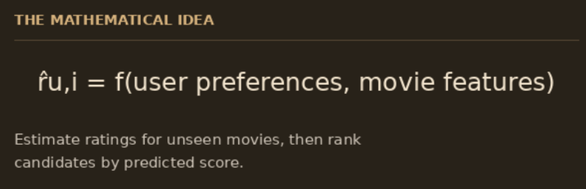
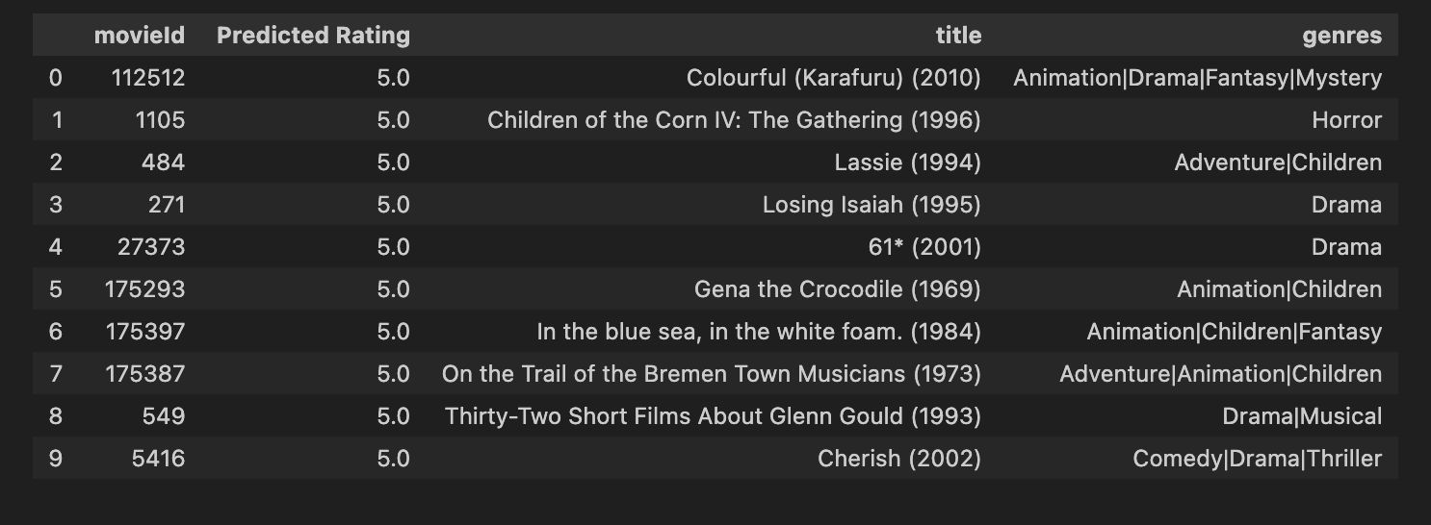
From Similarity to Recommendations
Your taste. Your next watch.
NextFlick combines collaborative filtering with a genre-based least-squares model to generate ranked movie recommendations.

Slide 8
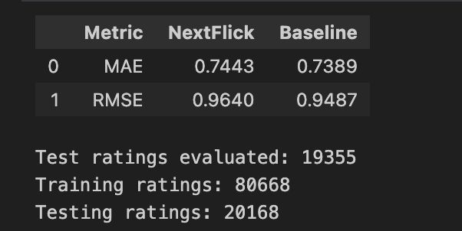
How accurate are the recommendations?
HOW WELL DOES IT PREDICT?
MAE — Average absolute difference between predicted and actual ratings.
RMSE — Penalizes larger prediction errors more heavily.
Baseline — A reference score to judge whether our model improves prediction.

Slide 9
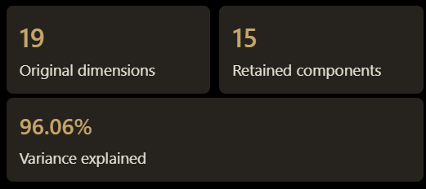
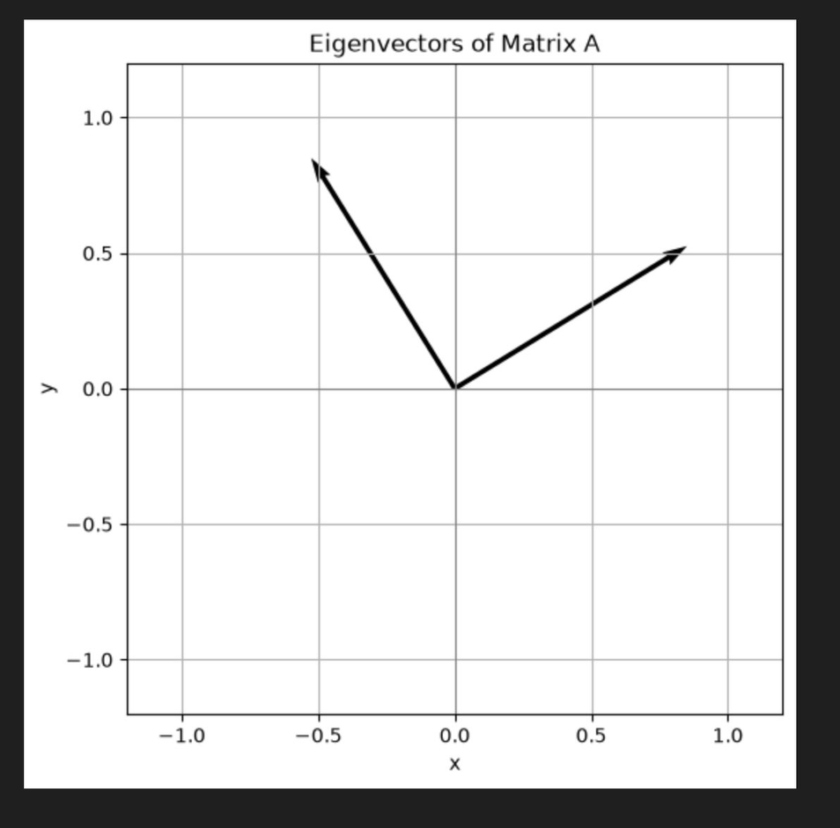
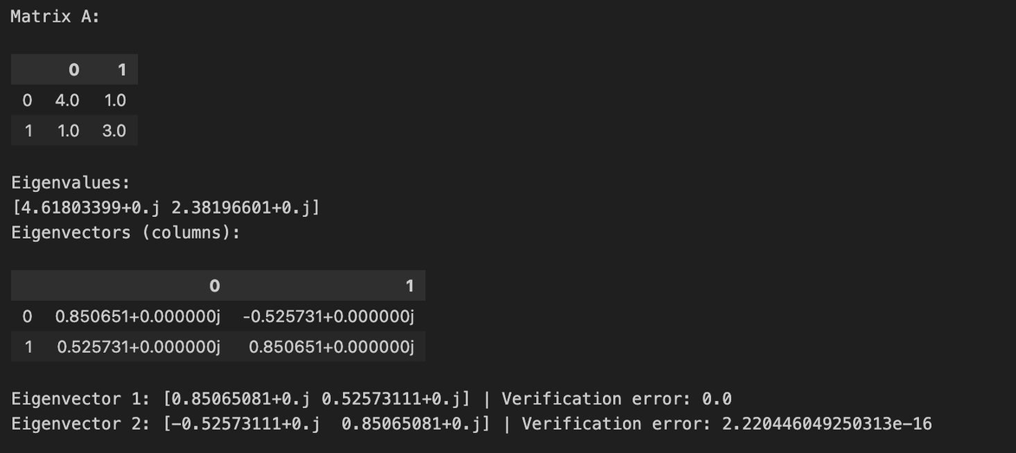
Reducing Dimensions, Preserving Information
THE KEY RESULTS

Slide 10
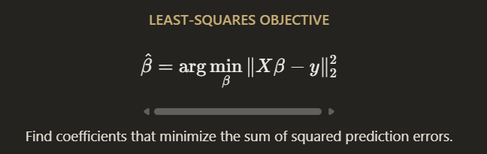
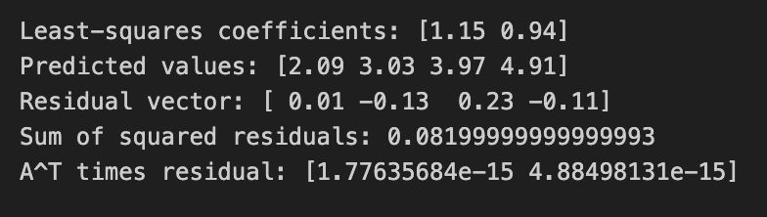
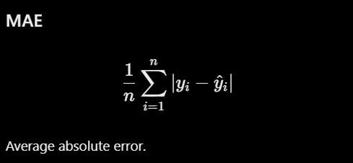
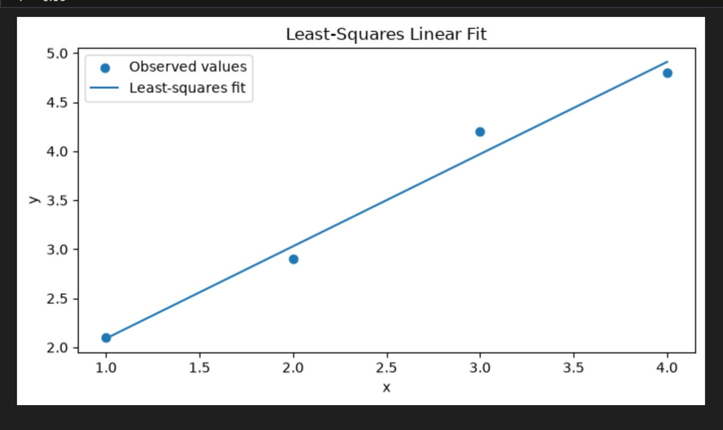
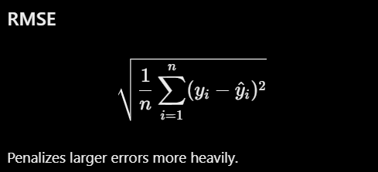
Least Squares & Prediction Error
MINIMIZING THE ERROR

Slide 11
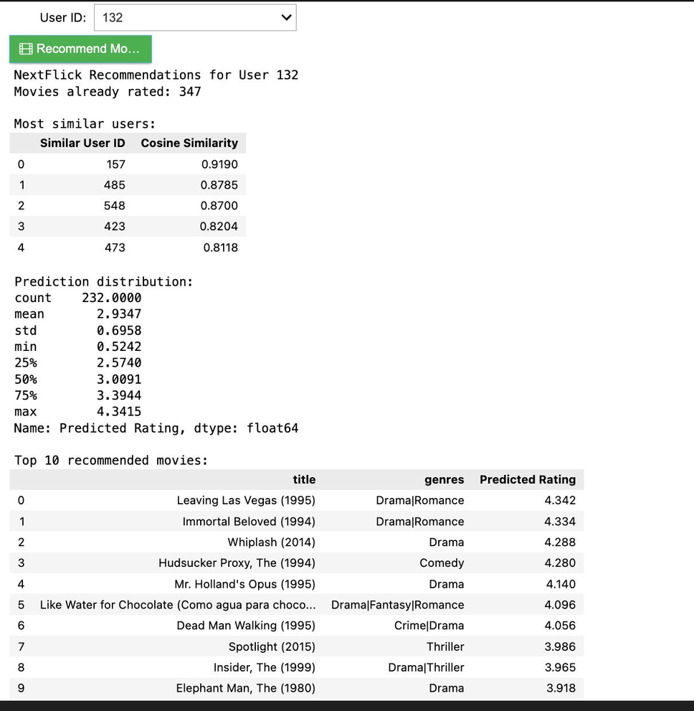
Actual vs Predicted Ratings
PREDICTING WHAT USERS WILL RATE
KEY INSIGHT
The predictions estimate a user's rating for movies they have rated, allowing us to inspect the model's errors.

Slide 12
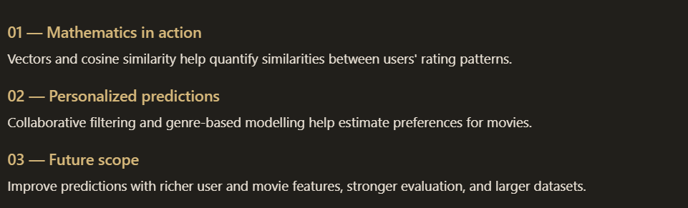
FROM RATINGS
TO RECOMMENDATIONS

Slide 13
THANK
YOU
Sushveen Kaur | Sowjanya M N | Srushti Puranik | Sujith R Chiknar
PES1UG25AM416 | PES1UG25AM402 | PES1UG25AM408 | PES1UG25AM412

